Slide 1

Automotive SPICE AWARENESS

Slide 2
Objective
Understand the ASPICE model basic concept and definition
Understand some key points to comply ASPICE model

Slide 3

Content
ASPICE model basic concept and definition
Differences between ASPICE and some other models/standards
Some key points of ASPICE implementation

Slide 4
ASPICE model basic concept and definition

Slide 5
What is Quality *
Quality in brief definition is “Fit for use”
Procedures and methods defining the relationship of tasks
Quality
Tools and equipment
Technical know-how
Process
Technology
Quality of a software system is governed by the quality of the
process used to develop and evolve it
People
People with skills, training and motivation
Notes:
Quality: has some definitions
zero defect/ meet req/ fit for use

Slide 6
What is ASPICE*
ASPICE (Automotive Software Process Improvement and Capability dEtermination), is a set of technical standards documents for the computer software development process and Automotive related business management functions.
ASPICE is a process oriented model
2 dimensions of view
Process dimension
(Software Process Improvement)
Capability dimension
(Software Process Capability dEtermination)
Notes:
ASPICE: là tên gọi chung cho phần thứ 5 của tiêu chuẩn ISO 15504, là một bộ tài liệu tiêu chuẩn kỹ thuật cho quá trình phát triển phần mềm máy tính và các chức năng quản lý kinh doanh liên quan đến Ô tô

Slide 7
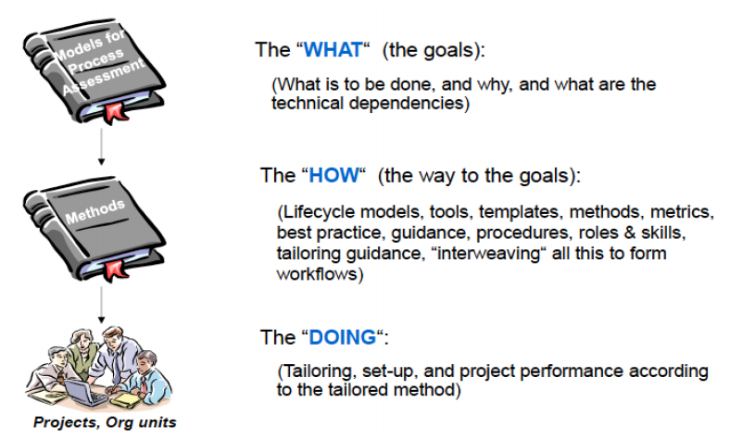
ASPICE – Approach *
ASPICE prescribe the “WHAT”, not the “HOW”

Slide 8
Differences between ASPICE and some other models/standards

Slide 9
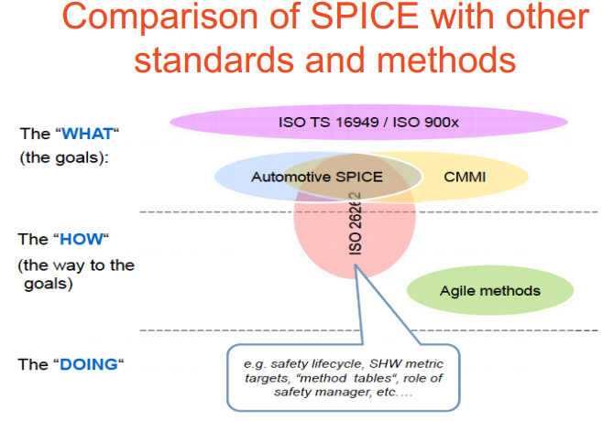
ASPICE with other standards
ASPICE, CMMi, ISO TS 16949 and other ISO900x are only defined the “WHAT”
ASPICE and ISO 26262 are both defined the “WHAT” but ISO 26262 also define the “HOW” with safety lifecycle,, SHW metric targets,…
AGILE is only define the “HOW” then they can be applied for many models/ standards

Slide 10
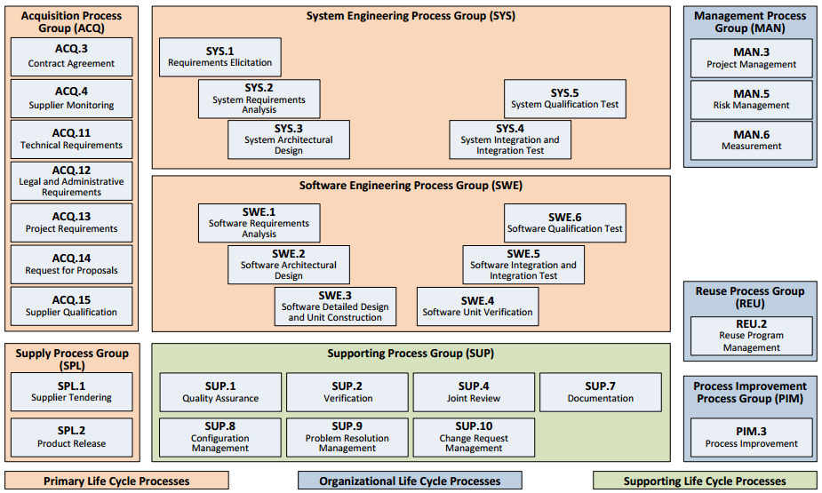
ASPICE – process dimension *
Red frame= Processes of VDA scope
Sys.1~Sys.5, ACQ.4 is out of scope of FSOFT/GAM
Notes:
E.g: For VDA scope you have 11 processes to apply in your company (MAN.3, SUP.1, SUP.8,9,10, SWE.1,2,3,4,5,6), all 11 processes are assessed as Level 3 -> your company reach the ASPICE L3 certificate of VDA scope.

Slide 11
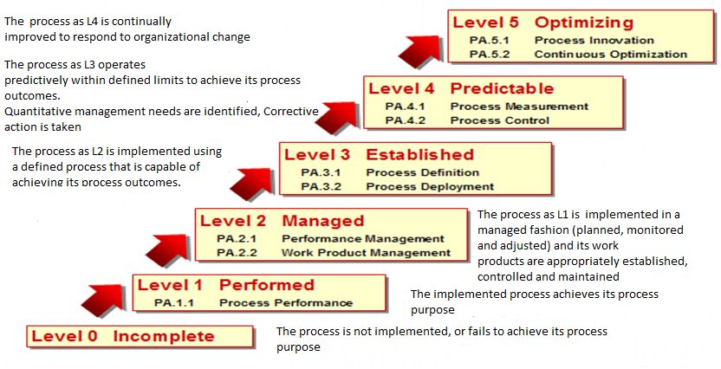
ASPICE – Capability dimension *

Slide 12
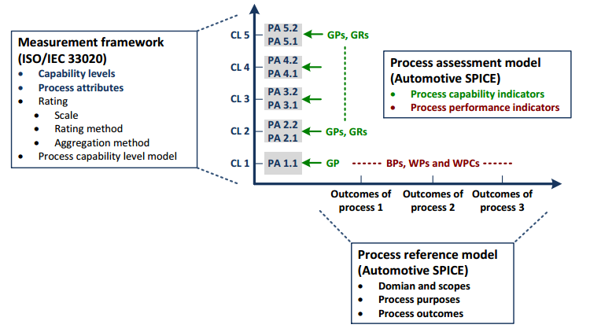
ASPICE – 2 dimension view
If you want to reach the appropriate level of maturity, you must put all your processed under the corresponding level.
Notes:
E.g: For VDA scope you have 11 processes to apply in your company (MAN.3, SUP.1, SUP.8,9,10, SWE.1,2,3,4,5,6), all 11 processes are assessed as Level 3 -> your company reach the ASPICE L3 certificate of VDA scope.

Slide 13
ASPICE – Process interaction
- All processes are planned, monitored and adjusted following Project Management procedure include PM activities themselves.
- All processes quality are verified following Quality Assurance procedure include QA activities themselves.
- All processes products are put under control of Configuration Management process include CM products themselves.
- All processes non-conformances are put under control of Problem Resolution Management include this process’ non-conformances themselves.
- All changes are put under control of Change Request Management include this process’ changes themselves.
Support (QA, CM, PRM, CRM)
Software Engineering
Project Management

Slide 14
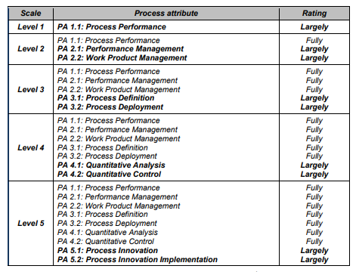
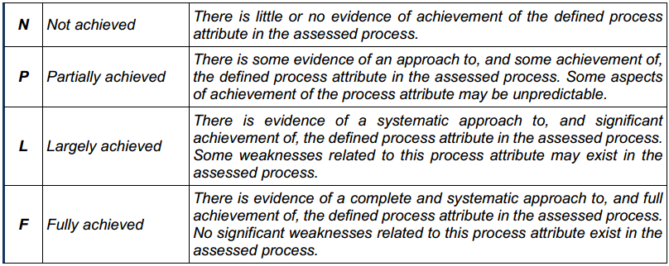
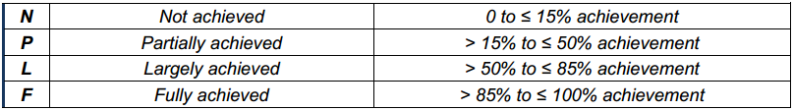
ASPICE – terms and definitions*
Rating: rating is a measurement framework to measure the process capability by using defined rating scale with an option for refinement, different rating methods and different aggregation methods depending on the class of the assessment
Rating scale

Slide 15
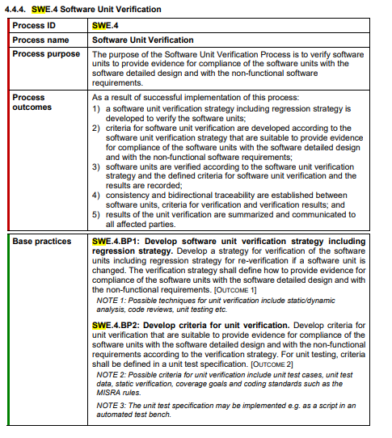
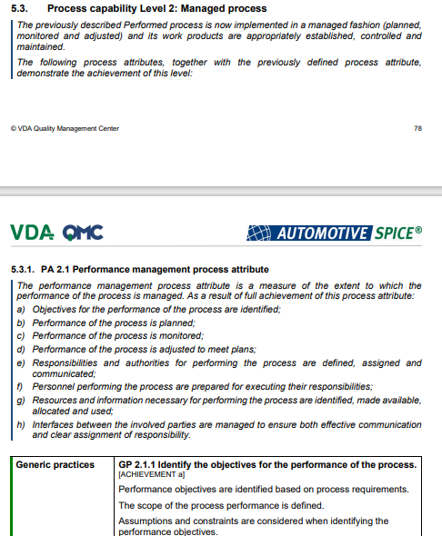
ASPICE – terms and definitions
Process reference model
* source: ASPICE_PAM_v3.0
Sample

Slide 16
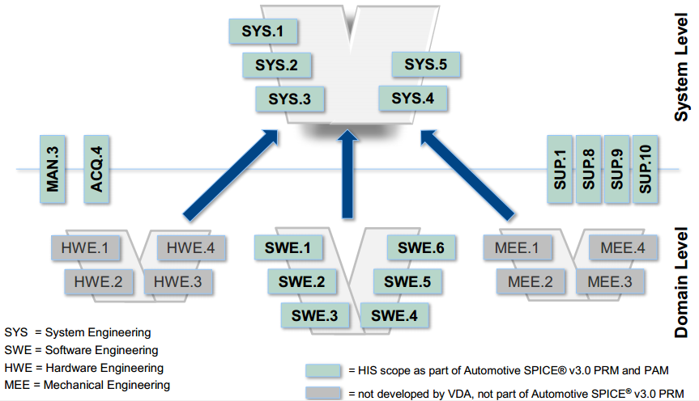
ASPICE – terms and definitions
“Plug-in” concept
* source: intacts
Notes:
The top-level comprises all system engineering processes organized in a system "V". Depending on the product to be developed the corresponding engineering disciplines with their domain-specific processes (e.g. hardware engineering HWE, mechanical engineering MEE, or software engineering SWE) can be added to the assessment scope. All other processes such as management processes and supporting processes are domain-independent and are therefore designed in a way that they can be applied to both the system level and the domain levels.

Slide 17
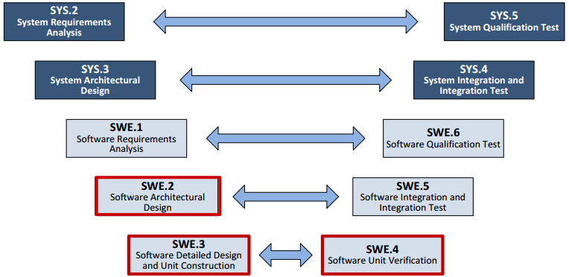
ASPICE – terms and definitions
Tip of the V *
* source: intacts

Slide 18
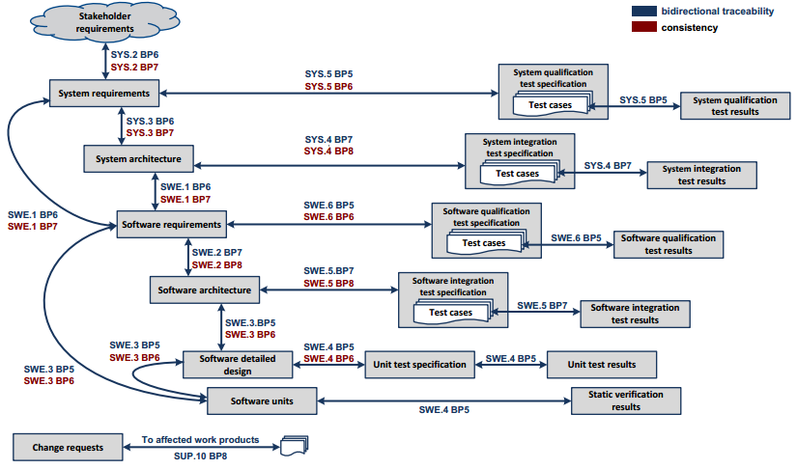
ASPICE – terms and definitions *
Traceability and consistency *
Traceability refers to the existence of references or links between work products. Traceability supports coverage analysis, impact analysis, requirements implementation status tracking etc.
Consistency means that - All traceability references/links are available (i.e., nothing is missing) - All traceability references/links are correct (i.e., not linking to the wrong work product) - Consistency has to be proven by technical review of the traceability
* source: intacts

Slide 19
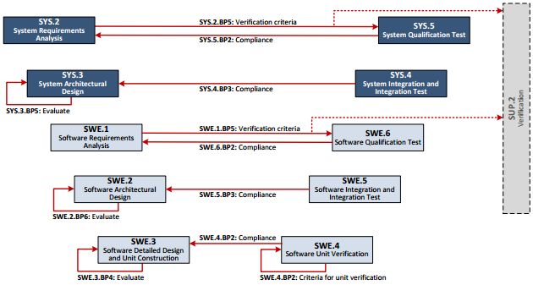
ASPICE – terms and definitions
“Verification criteria” (for requirements processes only): are used as input for the development of the test cases or other verification measures. Verification aspects which cannot be covered by testing are covered by the verification process (SUP.2).
Evaluation of alternative solutions is required for system and software architectures. The evaluation has to be done according to defined criteria. Such evaluation criteria may include quality goals or make-or-buy. The evaluation result including a rationale for the architecture/ design selection has to be recorded.
Compliance with an architectural design means that the specified integration tests are capable of proving that interfaces and relevant interactions like e.g. dynamic behavior between - the software units, - the software items and - the system items fulfill the specification given by the architectural design.
* source: intacts

Slide 20
Some key points of ASPICE implementation

Slide 21
Key aspects of MAN.5 – Risk MNG

Slide 22
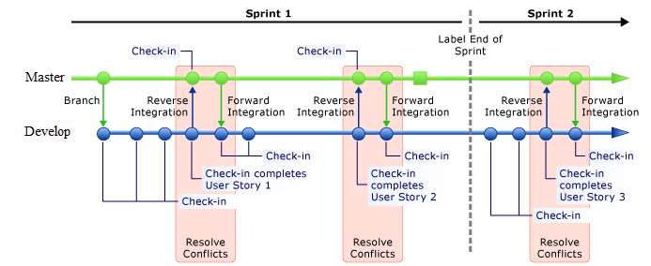
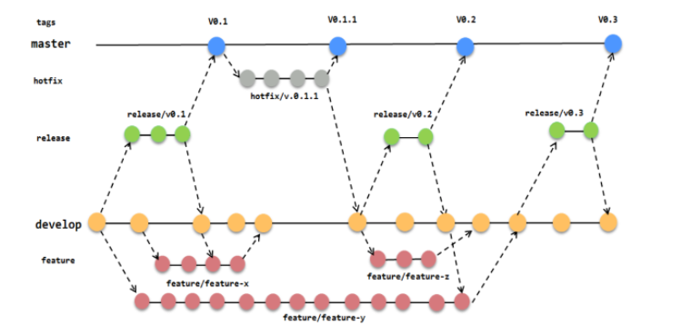
Key aspects of SUP.8 - CM
Branch management – ensure the integrity of source code
Branch management roles:
Branch create/delete/change: CM
Maintenance & management:
+ Master branch: CM/PM/PTL
+ Hot-fix branch: CM/PM/PTL
+ Other branches: All
Merge branch: CM/PM/PTL
If you must implement updates on releases, creating a branch for a release helps your team continue to work independently on the next sprint without creating conflicts with future releases

Slide 23
Key aspects of SUP.9 - Problem Resolution
Urgent case implementation – authorized person
If CC is raised to any levels of company (including project level), the corresponding head of department is the PIC to resolve it. E.g: CC raised to the Fsoft BOD, CDO is the PIC; CC raised to the FSU level, DH of FGA is the PIC; CC raised to BU level, BUL is the PIC. SM is PIC for CC at project level.
Customer Complains
ISM Incidents
issue which related to security will be followed as ISM policy
blocker/fatal defect/bug detected from project product will be raised directly to Project Technical Leader
Defects
critical problem happened in project impact to project performance, productivity and quality that raised by customer will be in charged by SM
Issues

Slide 24
Key aspects of SUP.10 -Change Request
Analysis the change request in Change Request Form – the necessary step before implementing change to project
Overall impact description
Describe impact as clearly as possible; include timescales, dates, dependencies, design, testing and acceptance, impact on plans, deliverables, schedules etc.
Impact analysis
Detail business impact description
1. Descripts detail the business area affected, for example:
- Networks
- Customer Service…
2. Descripts detail each impact to function or work product
3. Mapping each impact with requirement ID
4. Indicate how much effort (in days) will be required for each impact to be developed

Slide 25



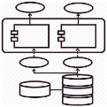
Overall about SWE.1
Guideline Software Requirement Analysis
Template SRS
SRS review checklist
Internal input
External input
External Interface
Use case diagram
Functional requirement
Non-functional Requirements
Design Constraints
System Requirement Spec
System Architectural Design
Traceability SRS to SyRS
Traceability SRS to SyAD
Business Analyst

Slide 26

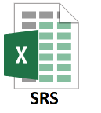
Overall about SWE.2
Template SAD
Template Design Evaluation
SAD review checklist
Internal input
Overall Software Architecture
Software component description
Task structure design and scheduling
Resource consumption
Sequence diagram
Failure handling
Interface design
External input
Software Requirement Spec
System Architectural Design
Software Architect
Traceability SAD to SRS

Slide 27



Overall about SWE.3
Template SDD
SDD review checklist
Coding convention
Coding tool
Internal input
External input
Software unit description
Unit State transition design
Unit algorithm design
External unit interface
Coding convention
Software Architectural Design
Traceability SDD to SAD
Traceability SDD to Coding
Traceability coding to SRS
Software Developer

Slide 28



Overall about SWE.4
Template UT specification
UTS review checklist
Coding convention
Coding tool
Static analysis tool
Template Test plan
Internal input
External input
Unit Test plan
Unit Test specification
Static analysis report
Unit Test result
Software Detailed Design
Traceability UTS to SDD
Traceability UTR to UTS
Traceability static analysis result to Coding
Source code
Software Developer

Slide 29
Overall about SWE.5
Template IT specification
ITS review checklist
Template Test plan
Template Software Integration plan
Internal input
External input
Integration Test plan
Software Integration plan
Integration Test specification
Integration Test result
Software Architectural Design
Traceability ITS to SAD
Traceability ITR to ITS
Source code
Software Tester

Slide 30

Overall about SWE.6
Template SQT specification
SQTS review checklist
Template Test plan
Internal input
External input
Software Qualification Test plan
Software Qualification Test specification
Software Qualification Test result
SRS
SAD
Traceability SQTS to SRS
Traceability SQTR to SQTS
Source code
Software Tester

Slide 31
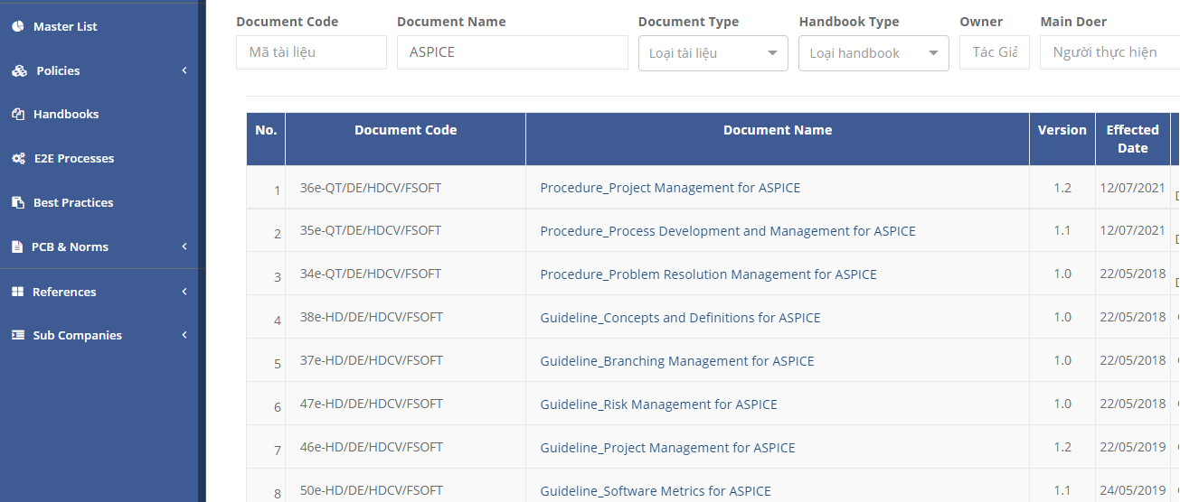
Fsoft QMS about ASPICE
QMS Announcement by SEPG department

Slide 32
Thank you

